Slide 1
Facial Recognition on Masked/Unmasked Faces Using CNN
Zach Quinn
Bellevue University

Slide 2
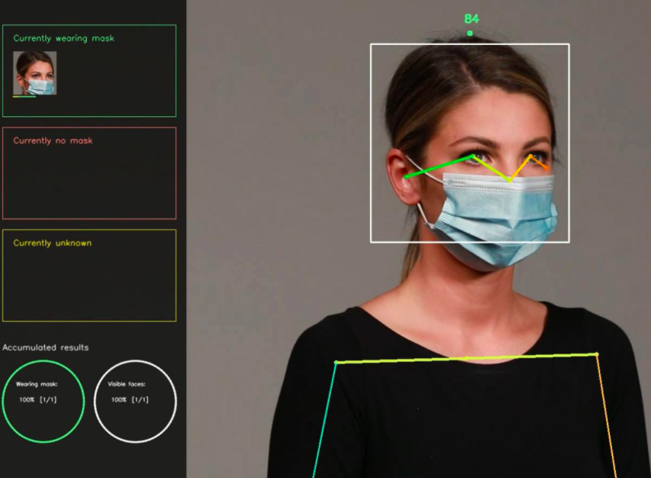
The Project at a Glance
Business problem: Masks confuse facial recognition software, a $15 billion industry (Fortune Business Insights, 2020).
Goal: Build model to reliably distinguish between masked and unmasked facial images
Methodology: Convolutional Neural Net (CNN)
Hypothesis: How can a CNN be developed to reliably distinguish between a dataset of masked and unmasked images with 85% accuracy?
Initial result: 97% accuracy at 30 epochs

Slide 3
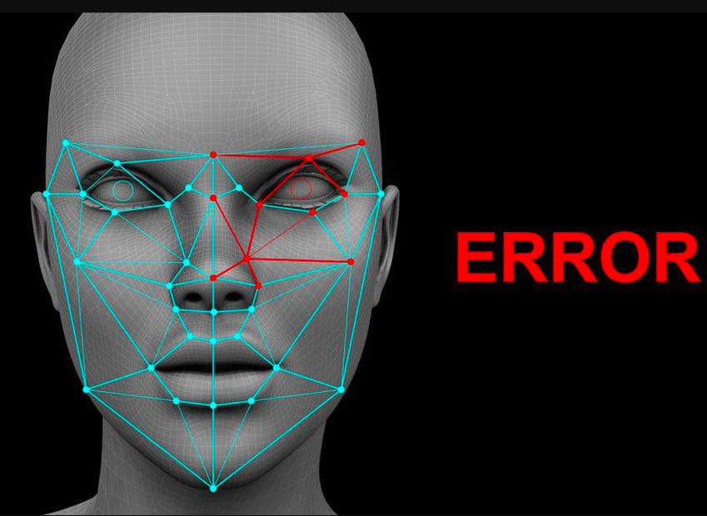
Facial Recognition
For decades only used for research purposes
1996: DOD/NIST allocated $7 million for U.S. citizen dataset (Kraus, 2021)
mid 2000s: Developers manually collected images
Today: Companies scrape the web for faces
Commercially, applications trained on 18 million faces
FBI reportedly has access to over 640 million images (double U.S. population) (Guliani, 2019)

Slide 4
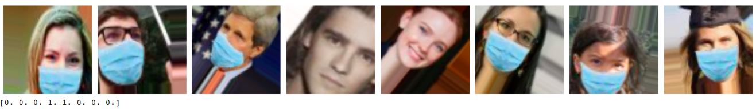
The Data
Open source repo courtesy of The Assembly
10,000 images belonging to two classes
Label encoded (0 – mask, 1 – no mask)
Train/test split: 80-20
Data augmentation
Lack of image data detrimental to this and many other facial recognition projects

Slide 5
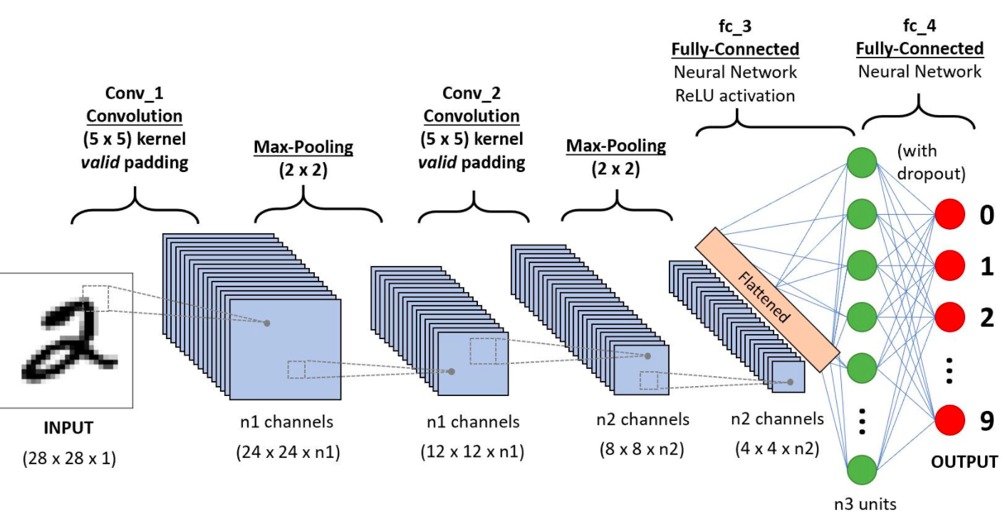
Model Background
CNN: Artificial network replicating neurological processes
Convolution: Mathematic operation explain how two functions are shaped by a third (Jeong, 2019)
Padding, flattening, stride
Dropout

Slide 6
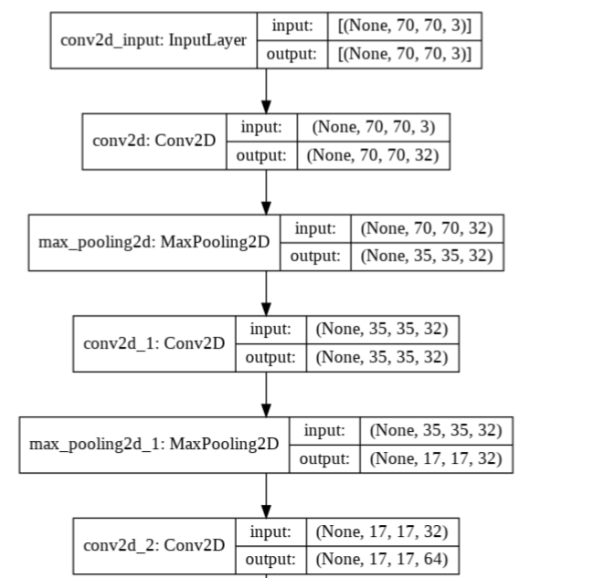
Model Illustration

Slide 7
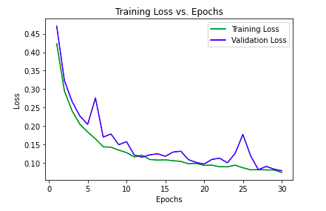
Evaluation - Loss

Slide 8
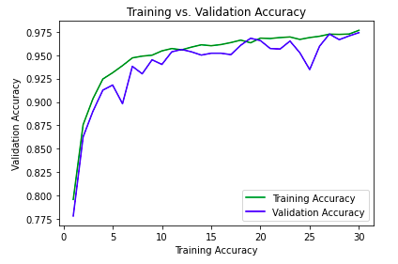
Evaluation - Accuracy

Slide 9
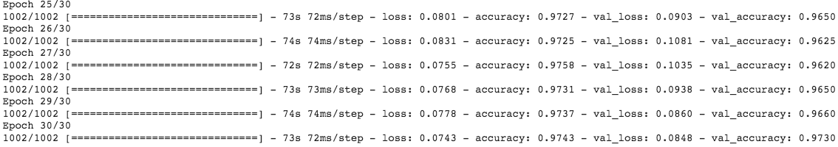
Results
Accuracy rate: 97%
Exceeded hypothesis target
Minimal loss
1st epoch: 50%
30th epoch: 7%

Slide 10
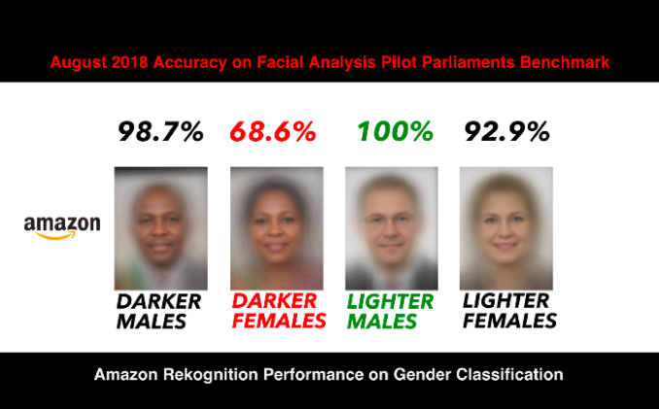
Challenges of Facial Recognition
Lack of data
Public perception
Invasion of privacy
Inaccuracy
NYC: 100% error rate
Racial bias: Wrongful arrests of black men
(Kraus, 2021)

Slide 11
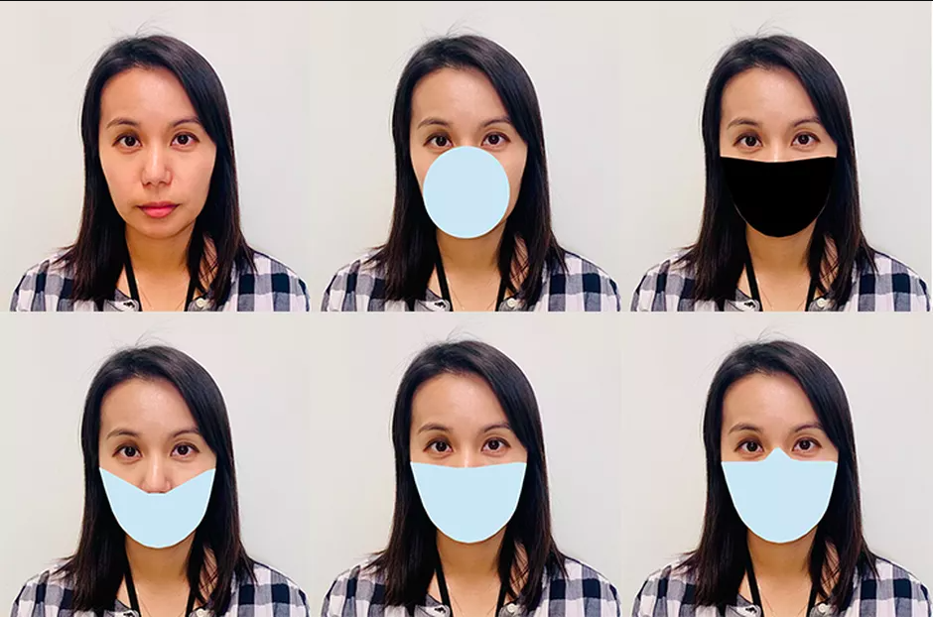
Conclusion
Masks pose new challenge to facial recognition (NIST, 2020)
Small and large firms racing to develop models to function on masked faces
More data needed to ensure applicability to ‘real-world’ situations

Slide 12
References (Images & Data)
Data: https://github.com/The-Assembly/Build-A-Face-Mask-Detector-With-TensorFlow/blob/main/FaceMask%20detection/data.zip
Woman being analyzed: https://www.nationalgeographic.com/content/dam/science/2020/09/11/face-mask-recognition/20200901_002_out_mp4_00_00_03_18_still003.ngsversion.1599834288519.adapt.1900.1.jpg
Facial recognition graphic: https://thumbor.forbes.com/thumbor/960x0/https%3A%2F%2Fblogs-images.forbes.com%2Fcognitiveworld%2Ffiles%2F2019%2F08%2Fdangers-of-facial-recognition.jpg
Amazon facial recognition: https://medium.com/@Joy.Buolamwini/response-racial-and-gender-bias-in-amazon-rekognition-commercial-ai-system-for-analyzing-faces-a289222eeced
Woman with multiple masks: https://cnet1.cbsistatic.com/img/j4tsKgnAHKeIIK7-JwTxknH8qHg=/940x0/2020/07/27/440f5d19-a0fa-4cb1-ba2d-3d4555ab8581/nist-masks.png

Slide 13
References (Academic)
Apple. (2020). About Face ID Technology. Apple. https://support.apple.com/en-us/HT208108#:~:text=The%20technology%20that%20enables%20Face,infrared%20image%20of%20your%20face
Fortune Business Insights. (2020). Facial Recognition Market Size, Share and COVID-19 Impact Analysis. Fortune Business Insights. https://www.fortunebusinessinsights.com/industry-reports/facial-recognition-market-101061
Guliani, N. (2019). The FBI Has Access to Over 640 Million Photos of Us Through Its Facial Recognition Database. American Civil Liberties Union. https://www.aclu.org/blog/privacy-technology/surveillance-technologies/fbi-has-access-over-640-million-photos-us-through
Heilweil, R. (2020). How can we ban facial recognition when it’s already everywhere? Vox. https://www.vox.com/recode/2020/7/3/21307873/facial-recognition-ban-law-enforcement-apple-google-facebook
Jeong, J. (2019). The Most Intuitive and Easiest Guide for Convolutional Neural Network
Kraus, R. (2021). 9 Scary Revelations from 40 years of Facial Recognition Research. Mashable. https://mashable.com/article/facial-recognition-databases-privacy-study/
NIST. (July 2020). NIST Launches Studies into Masks’ Effect on Face Recognition Software. National Institute of Standards and Technology. https://www.nist.gov/news-events/news/2020/07/nist-launches-studies-masks-effect-face-recognition-software
Simonite, T. (2020). How Well Can Algorithms Recognize Your Masked Face? Wired. https://www.wired.com/story/algorithms-recognize-masked-face/
Telford, T. (2020). Top facial recognition tech is thrown off by masks, study says, but that could soon change. The Washington Post. https://www.washingtonpost.com/business/2020/07/29/masks-facial-recognition-error-rates/

